Slide 1
The roots of our success will be the path to our future
Two areas of our current markets have huge potential:
Detachable Tablets and
3D Printers

Slide 2
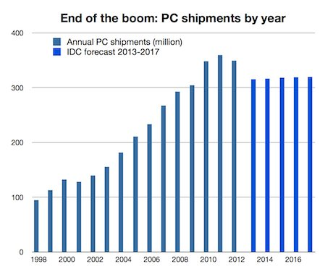
PC Sale Continue to Fall
PC sales have fallen short of projections due to weakening Chinese economy and a stronger dollar

Slide 3
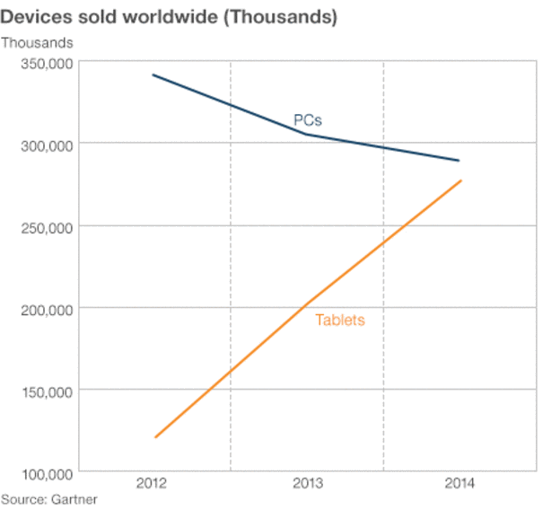
Detachable Tablet Sales Have Seen Double Digit Growth
Detachables are seen as the PC replacement

Slide 4
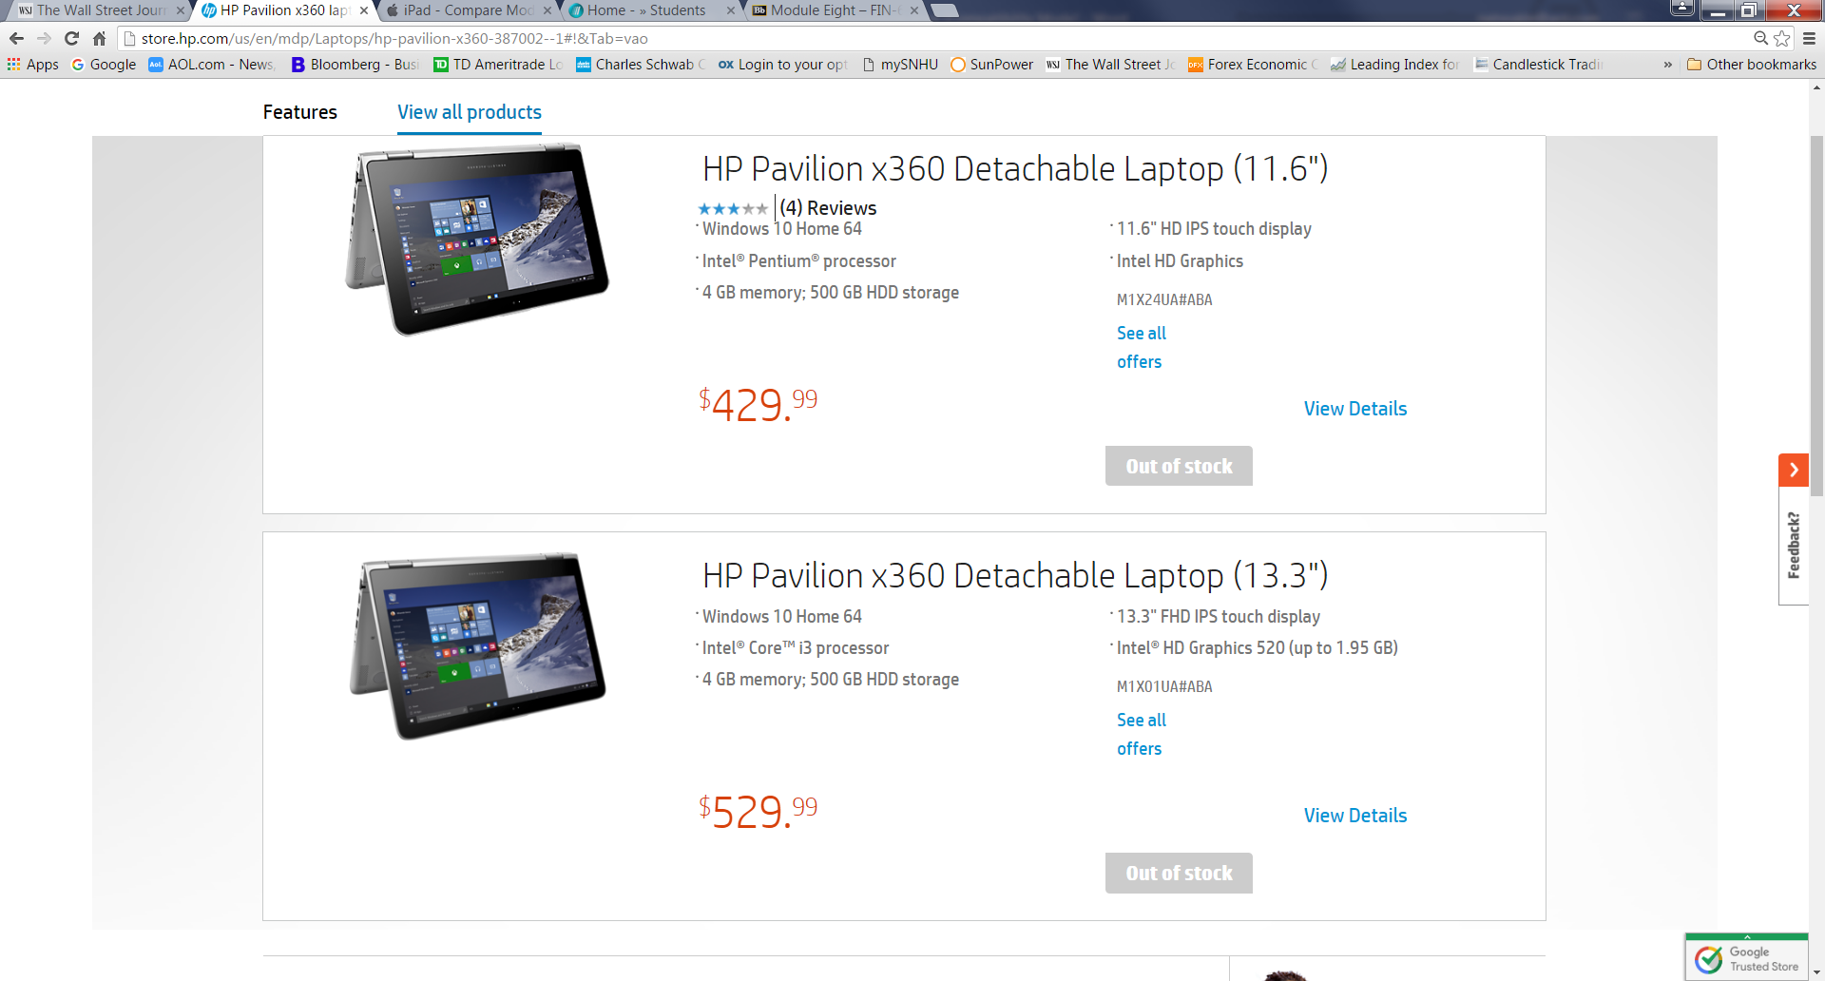
HP Must Meet This Demand
We cannot allow this to happen again, July 14, 2016, HP is out of this model detachable!

Slide 5

HP, long know for quality PCs can capitalize on this new trend in personal computing

Slide 6
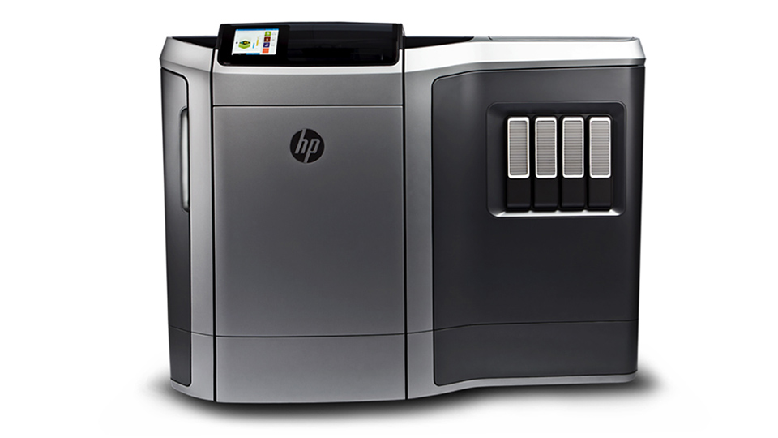
3D Printing Will Become Mainstream

Slide 7
HP Must Offer a Complete Line of 3D Printers
3D printers are being used in industry ranging from Automobile manufacturing to Yacht building and everything in between.
3D printing is changing medicine and dentistry as we know it.
3D printing is shortening prototype development by as much as 5 fold.
3D printing is making its way into consumer products

Slide 8
HP is Perfectly Positioned
HP can take advantage of these two exciting opportunities. They both dovetail perfectly into our current product lines.
HP office printers and support expanded to HP World Class 3D printers.
HP personal computers introduces a line of Detachable Tablets with full PC computing power, memory and portability.

